Slide 1

Name: Avanish Radheshyam Vishwakarma
Class: MSc IT Sem-IV Roll No : 41
Project Guide: Prof. Sneha Shirkar
(Using House Price Prediction)

Slide 2
INTRODUCTION
This project is developed for those who are searching property based on their criteria.
The Main Aim of this Project is to develop a Real Estate Web Application That Gives the functionality for buyers to get the predicted price of house by taking user input.
This project is designed to simplify the process of Real Estate in the matter of price of house.

Slide 3




PROBLEM STATEMENTS

Slide 4






Domain & Technology
Front End
Back End
Database
React is declarative, component based, learn once-write anywhere.
Provides Reusable Components
Easy to adopt
Better CDN connectivity and Content Management
Fast Processing
Django Provides a Default Admin Panel
It is a very light weighted database.
Provides better performance.
No installation neede

Slide 5
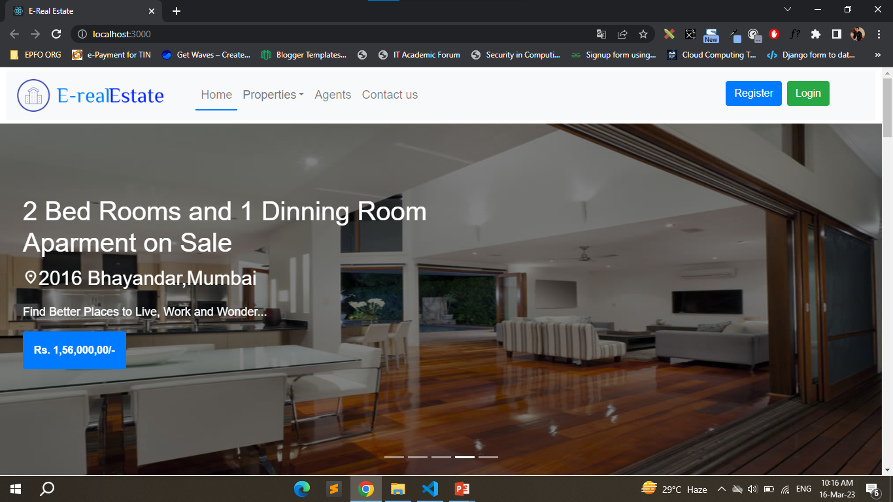
RESULTS

Slide 6
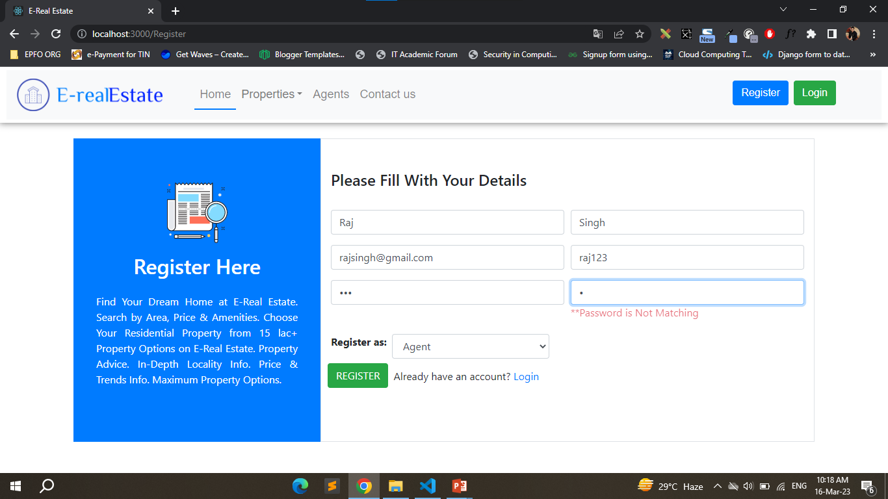

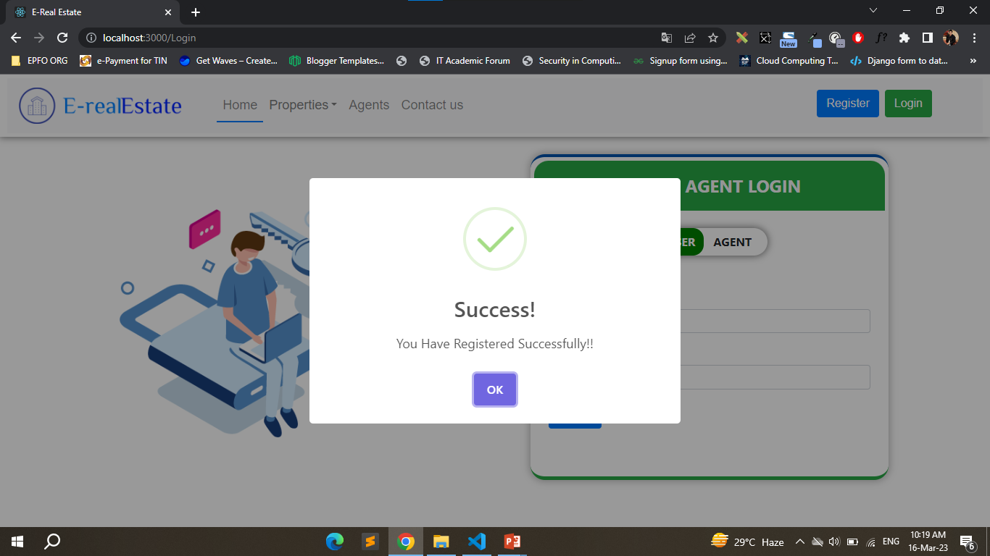
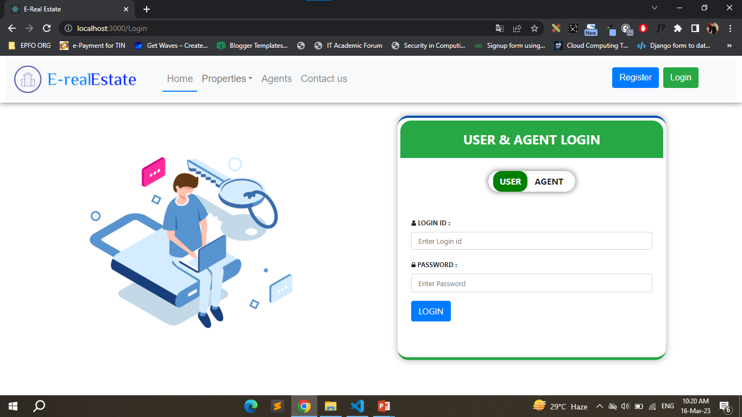

Slide 7
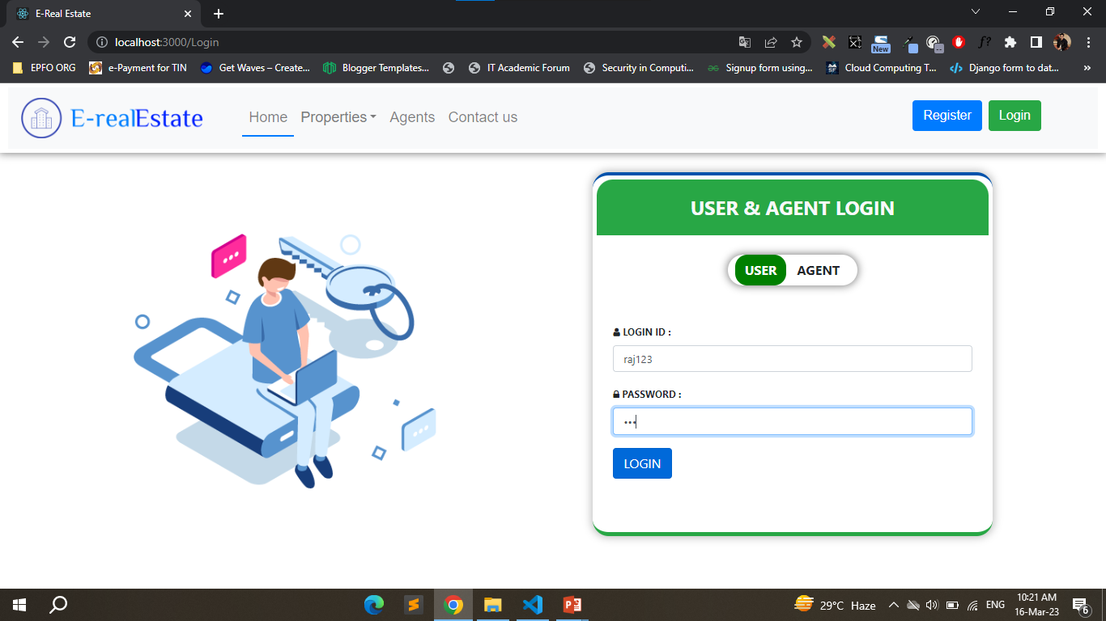
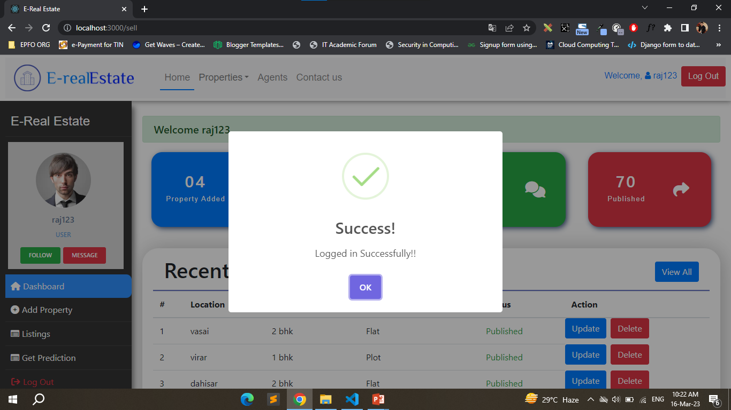
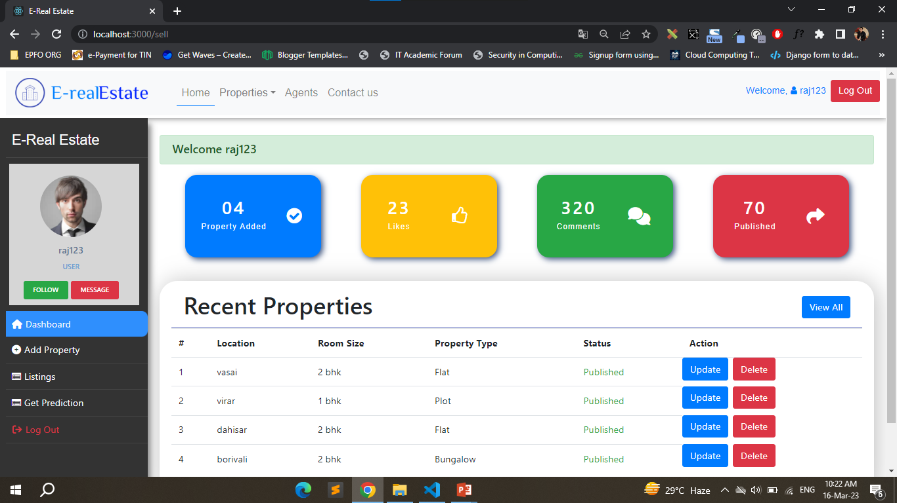

Slide 8
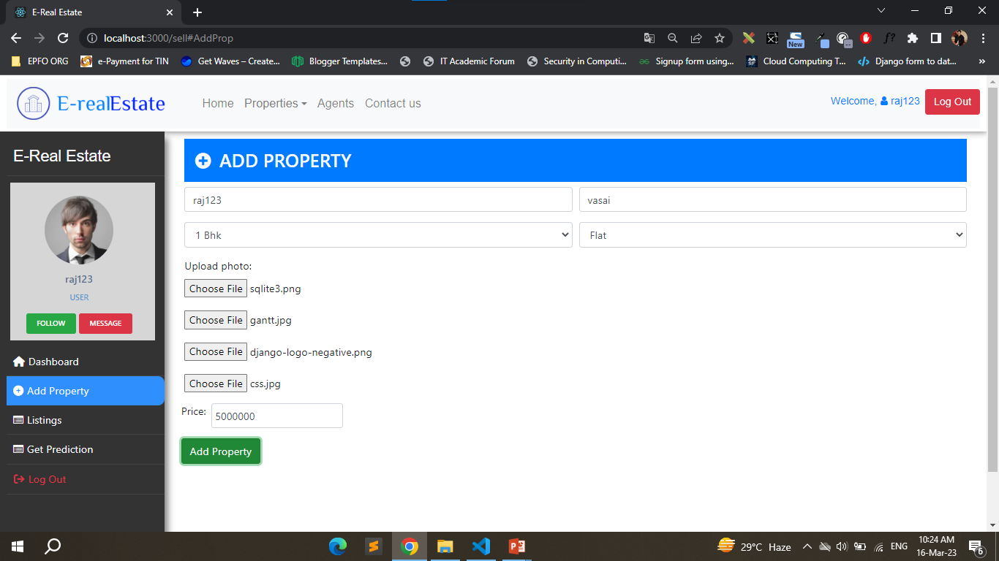
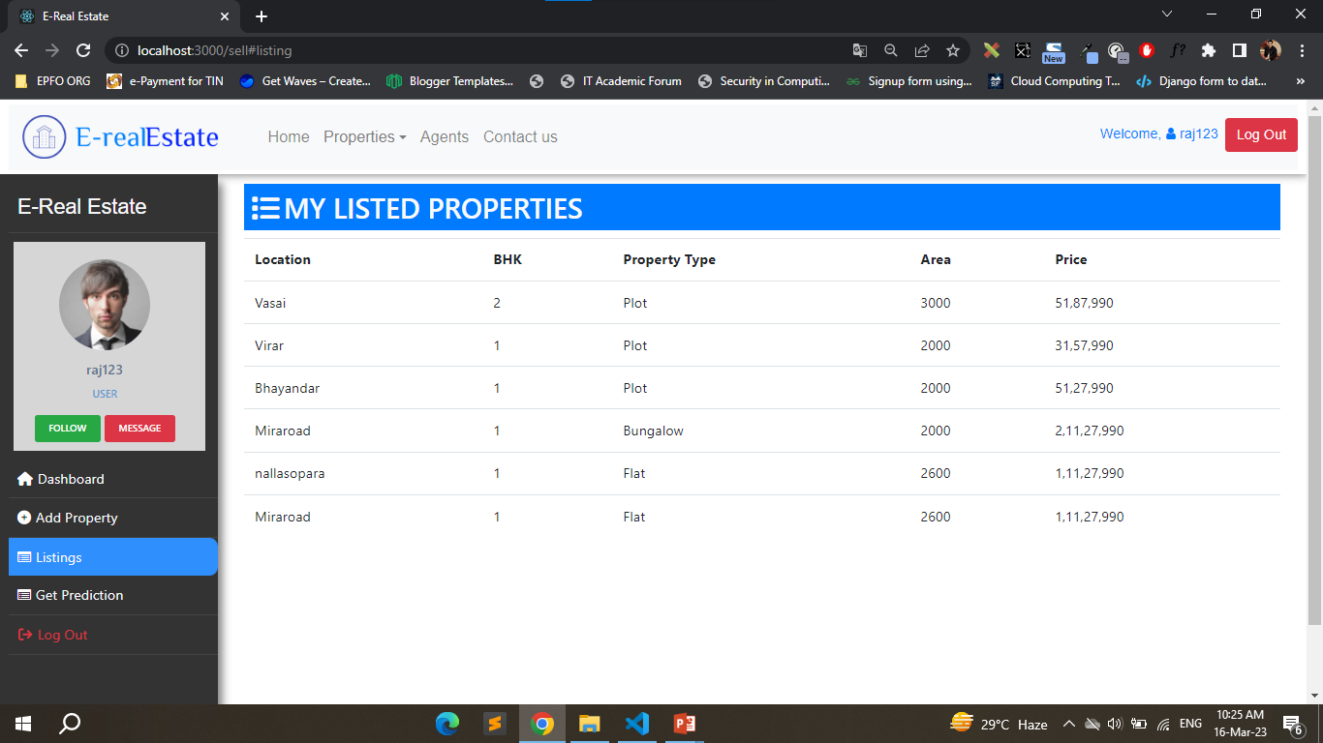

Slide 9
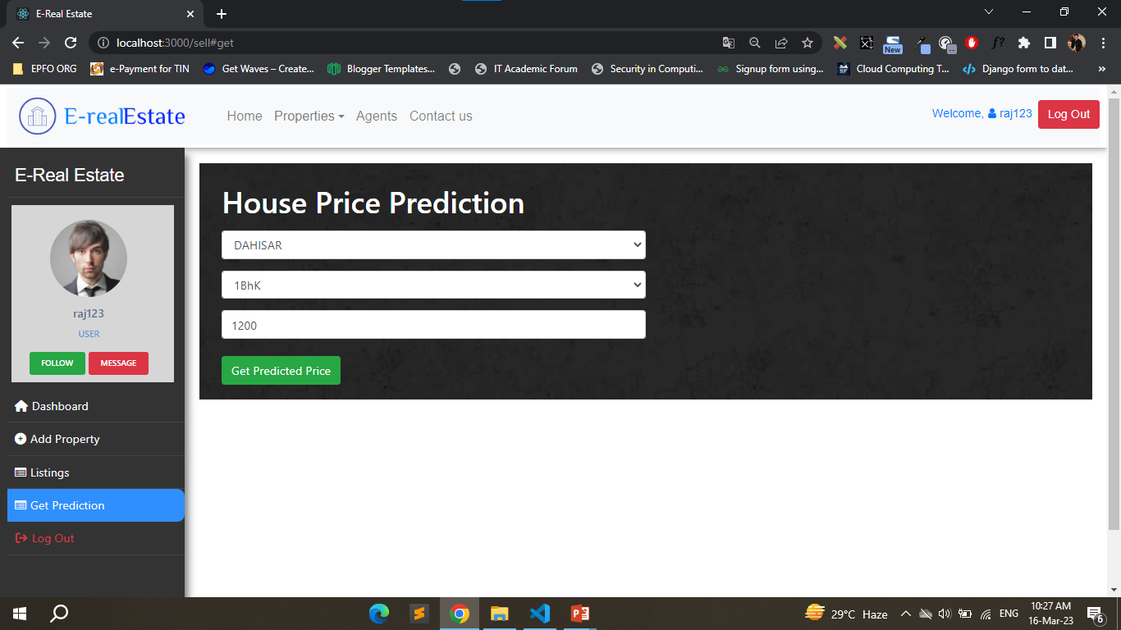
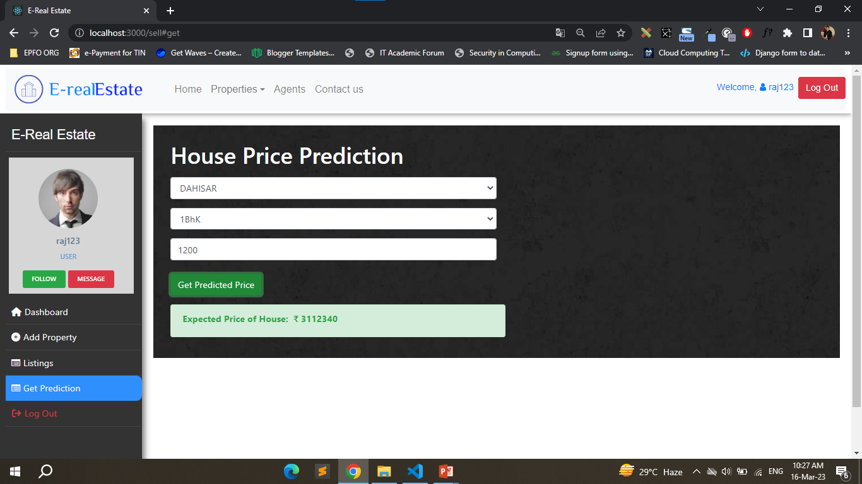

Slide 10
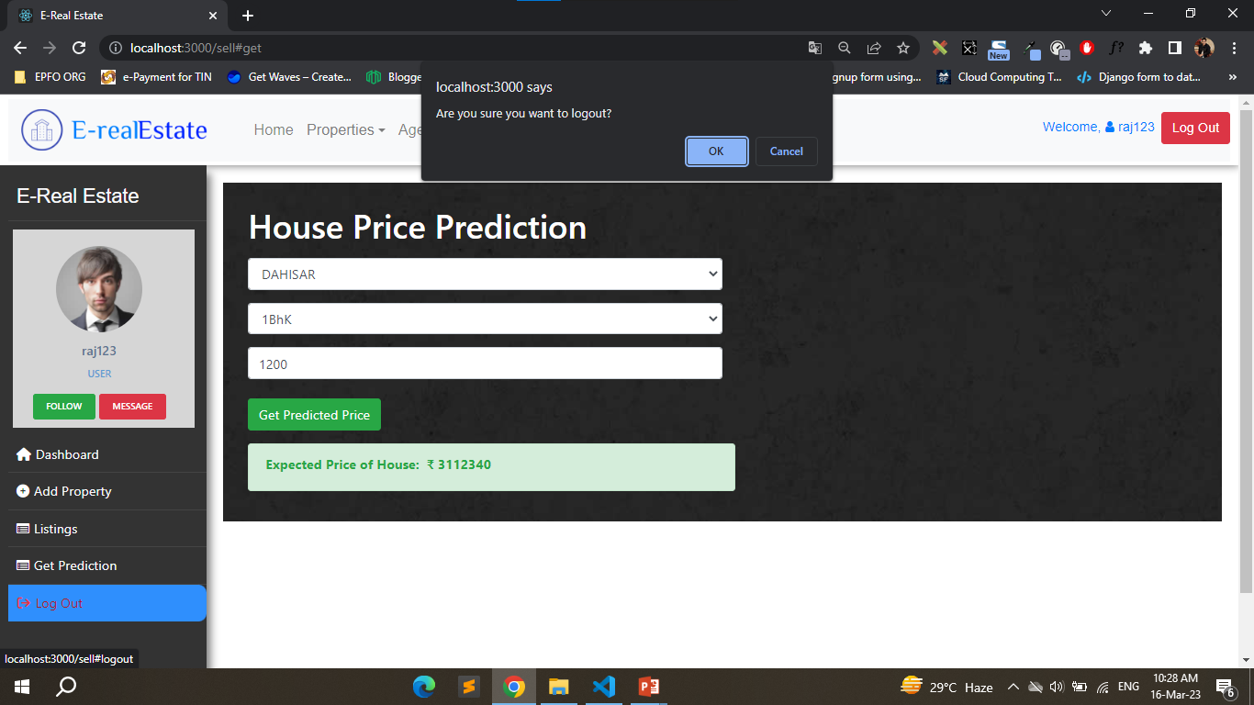
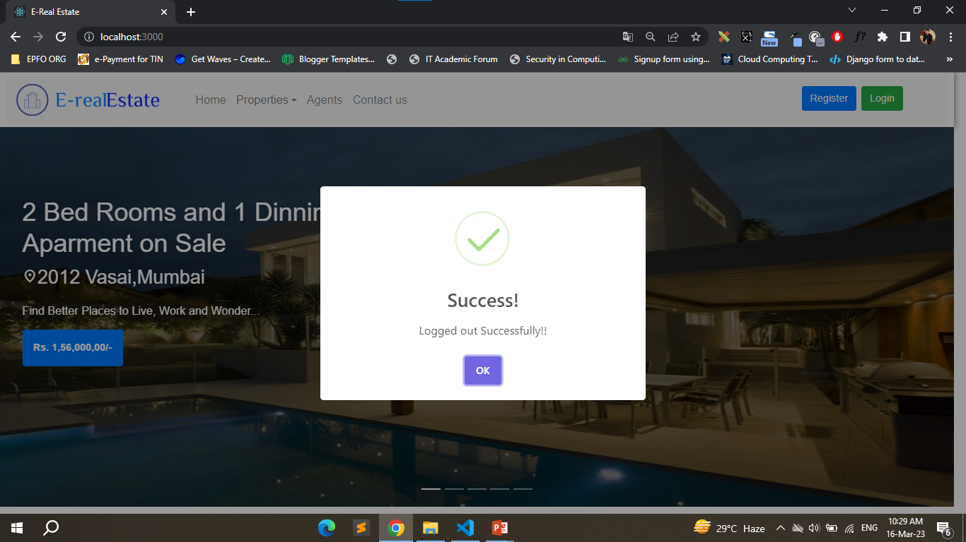

Slide 11
Conclusion
Finally, in the Project, I have developed a secure, user-friendly E-real Estate System.
This system is capable of taking care of each work that needs to be done in the real estate business. The client can log in using a username and password. This means the unauthorized user cannot enter into the system making it secure.
The House Price Prediction Algorithms Is implemented successfully that provides the predicted house price by taking user input.

Slide 12
THANK YOU!!

